Slide 1
Load Testing introduction
Tung NT – 2016-12-09

Slide 2
Topics
What is Load Testing?
Load Testing v.s. Volume Testing v.s. Stress Testing
Most valuable indicators
Some tools
Some notes

Slide 3
What is Load Testing?
Put demand on a software system (or computing device)
Measure the response
Identify the MAXIMUM operating CAPACITY, and bottlenecks as well as the element causing degradation

Slide 4
Different performance tests
Volume Testing: Large amounts of data
Target: See the performance under heavy data size/type
Load Testing: Large amounts of concurrent users
Target: See the system’s CAPACITY (thresholds where problem starts to occur)
Stress Testing: Many users, too much data, too little time …
Target: See if the system will perform sufficiently when the load exceeds expected maximum
Soak Testing: (or endurance test) continuous expected load
Target: See if the system can sustain, especially memory utilization (potential leaks) and the difference of response times at diff times compared to the first
Spike Testing: suddenly increase and decrease the load
Target: See if the performance will suffer or if the system will fail

Slide 5
Quick demo w/ Load Impact
https://loadimpact.com/
User senarios & Data stores
Test results
Load Impact User Scenario Recorder Chrome extension
API documentation: https://loadimpact.com/load-script-api
Monitoring
Integration & Continuous Integration

Slide 6
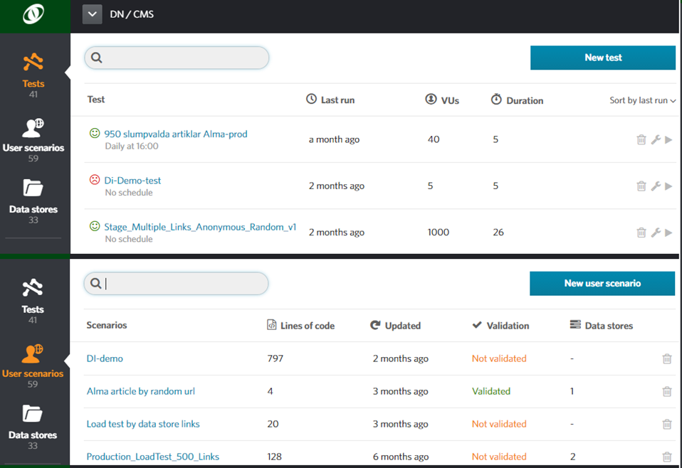

Slide 7
Most important indicators
Max requests/sec (reqs/sec at the time CPU% > 75%)
Min and Max page response time (Max number is at the time CPU% > 75%)
Failure rate (at the time system reaches the defined thresholds, especially when CPU% > 75%)
Different server info during the load test
Trend of number of concurrent users (VUs) and how it impacts the performance

Slide 8
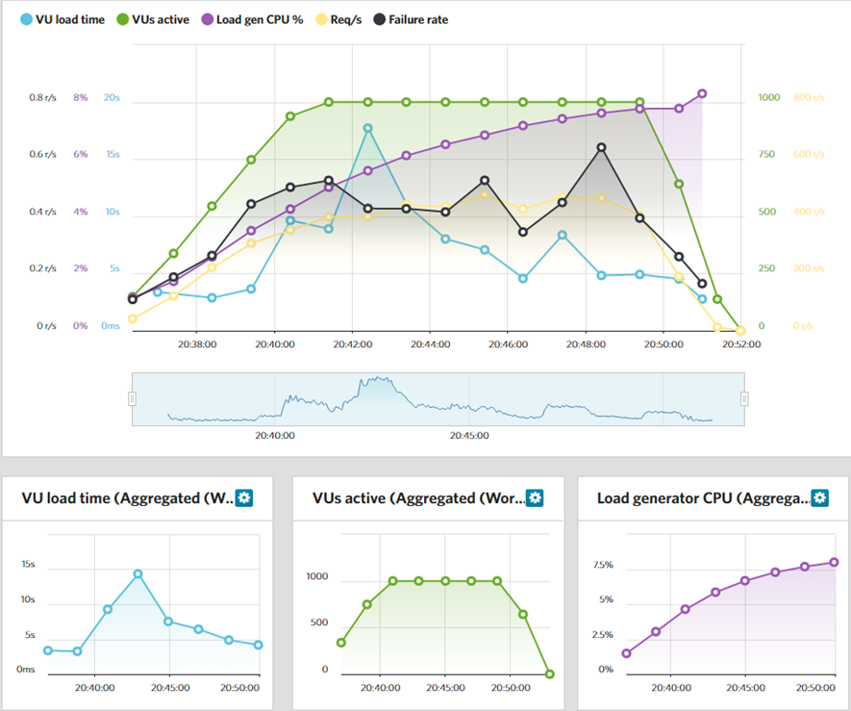

Slide 9
Some tools
Load Impact (demoed)
Visual Studio Load Test
ni-lta02
(Test agent 1)
ni-lta06
(Test agent 2)
ni-lta07
(Test agent 3)
ni-testctrlr02
(Test Controller)
ni-lta08
(Test agent 4)
ni-lta09
(Test agent 5)

Slide 10
Some notes
Reading theory is not enough, you need to START DOING IT.
Do not kill the network if you use Niteco Visual Studio Load Test environment
It is not enough to look at the indicators, you need to integrate all related numbers during the test to understand the root causes of the problem.
To do advanced tests with advanced load patterns or if security is included, you need programming skills, don’t be lazy, you CAN DO IT.
Niteco experts I know: Pelle Niklasson, Ngoc Nguyen, some BNP guys

